Slide 1
DB2 for the COBOL Programmer

Slide 2
DB2 – Module 2
DB2I and QMF

Slide 3
Learning objective
By the end of this module, the participants
will be able to
  Use DB2 Interactive
  Use Query Management Facility (QMF)

Slide 4
DB2I (DB2 Interactive) Primary Option Menu
MMA – EXTRA for Windows 95/NT
_
X
File Edit View Tools Session Options Help
DB2I PRIMARY OPTION MENU
SSID : DSN
COMMAND === >
Select one of the following DB2 functions and press ENTER.
1 SPUFI (Process SQL statements)
2 DCLGEN (Generate SQL and source language declarations)
3 PROGRAM PREPARATION (Prepare a DB2 application program to run)
4 PRECOMPILE (Invoke DB2 precompiler)
5 BIND/REBIND/FREE (BIND, REBIND, or FREE plans or packages)
6 RUN (RUN an SQL program)
7 DB2 COMMANDS (Issue DB2 commands)
8 UTILITIES (Invoke DB2 utilities)
D DB2I DEFAULTS (Set global parameters)
X EXIT (Leave DB2I)

Slide 5
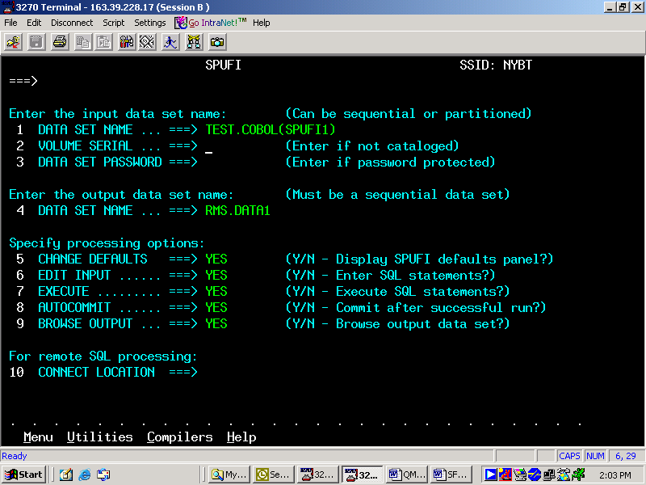
SPUFI panel 1

Slide 6
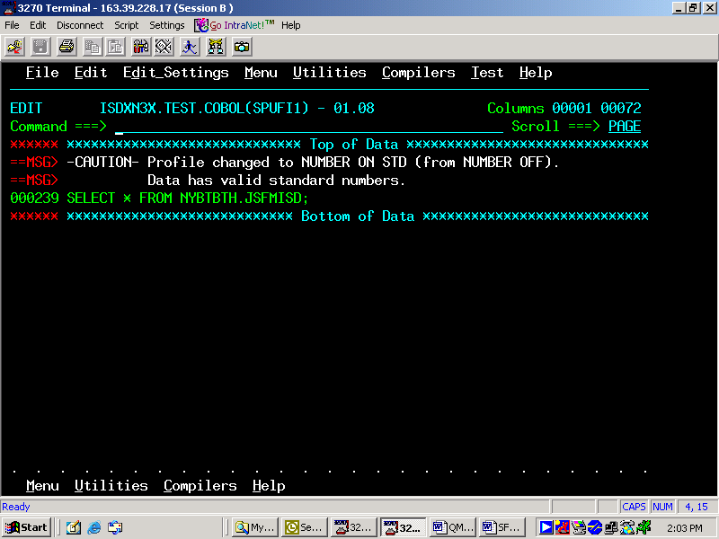
SPUFI panel 2

Slide 7
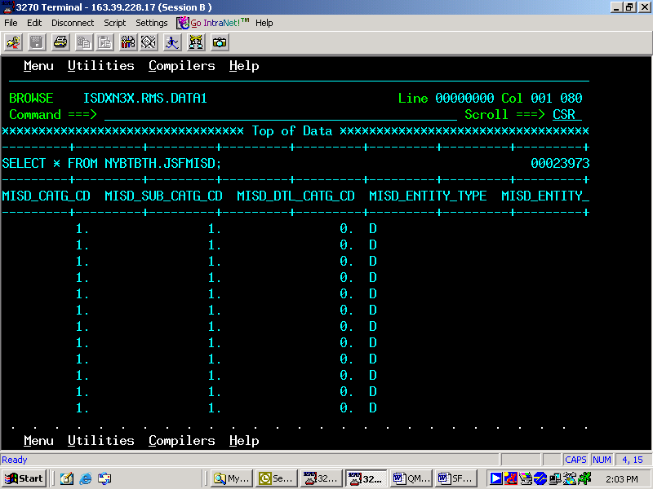
SPUFI panel 3

Slide 8
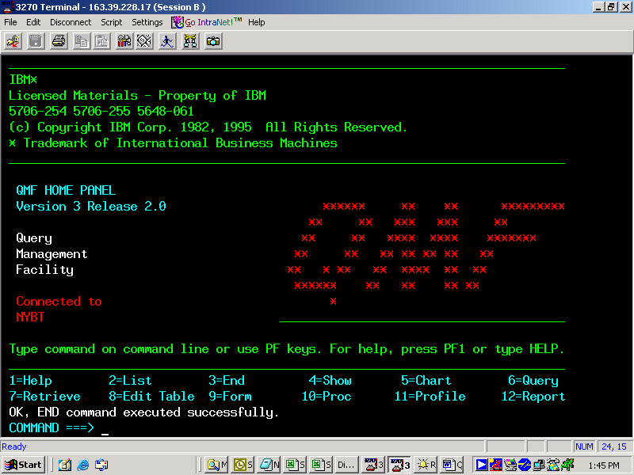
QMF (Query Management Facility)
SQL QUERY
MODIFIED LINE 1
COMMAND === >

Slide 9
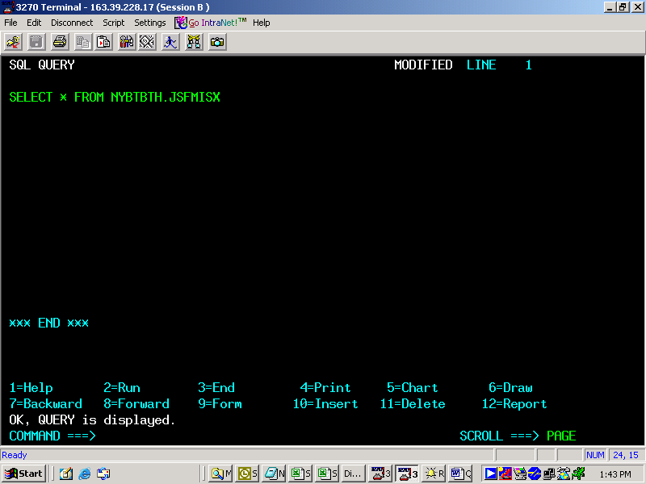
QMF panel 2

Slide 10
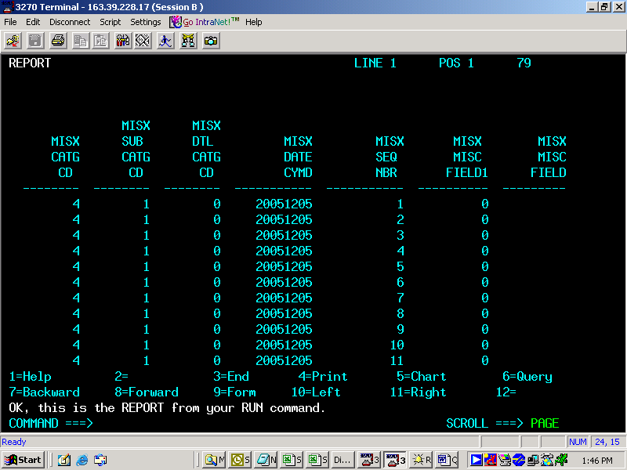
QMF panel 3

Slide 11
QMF panel 4

Slide 12
Winding up Module 2
DB2I
  SPUFI
QMF

Slide 13
THANK YOU

